Slide 1

Iris classification model

Slide 2
About the model
Purpose of the Model: The Iris Classification Model aims to accurately identify three species of Iris plants—setosa, versicolor, and virginica—based on their sepal and petal dimensions.
Application in Machine Learning: This model exemplifies the use of machine learning for pattern recognition and predictive modeling, serving as a foundational case study in the field.

Slide 3
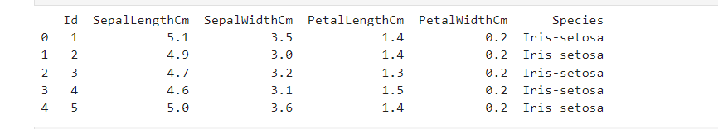
Dataset used
The dataset employed in this analysis was sourced from the sklearn library's dataset collection, a widely recognized repository for machine learning datasets.
Features:
Sepal Length (cm)
Sepal Width (cm)
Petal Length (cm)
Petal Width (cm)
The target variable is the species of the Iris plant.

Slide 4

Data preprocessing
Scaling: Features were scaled to have unit variance and zero mean to ensure equal weighting during model training.
Train-Test Split: Data was split into 70% training and 30% testing subsets to evaluate the model on unseen data.

Slide 5
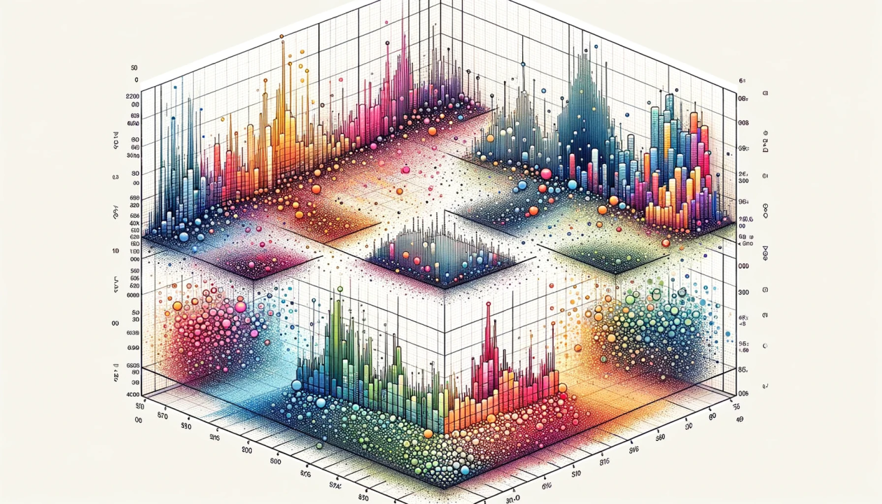

Exploratory Data Analysis (EDA)
Distribution of features: Plotted histograms to understand the distribution of each feature.
Pair plots: Used to visualize relationships between each pair of features and distinguish species based on feature interactions.

Slide 6
Algorithm used
The model was developed using the Random Forest Algorithm to handle the data and ensure high predictive accuracy.
Efficient and Robust Modeling: Random Forest adeptly handles complex feature interactions and reduces overfitting through averaging multiple decision trees.
Low Maintenance Requirements: Performs effectively with minimal preprocessing and default settings, streamlining the modeling process.
Versatile and Effective: Capable of managing both numerical and categorical data, ideal for maximizing insights from smaller datasets.

Slide 7

Model performance
Accuracy: Achieved approximately 97% accuracy on the test set, indicating high model performance.
Confusion Matrix: Provided detailed insight into the number of correct and incorrect predictions for each species.
Classification Report: Included metrics like precision, recall, and F1-score for each class to evaluate the model comprehensively.

Slide 8
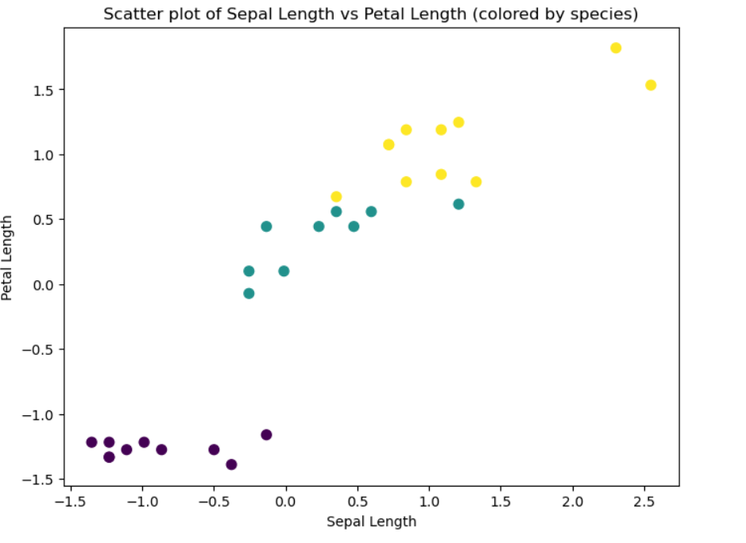
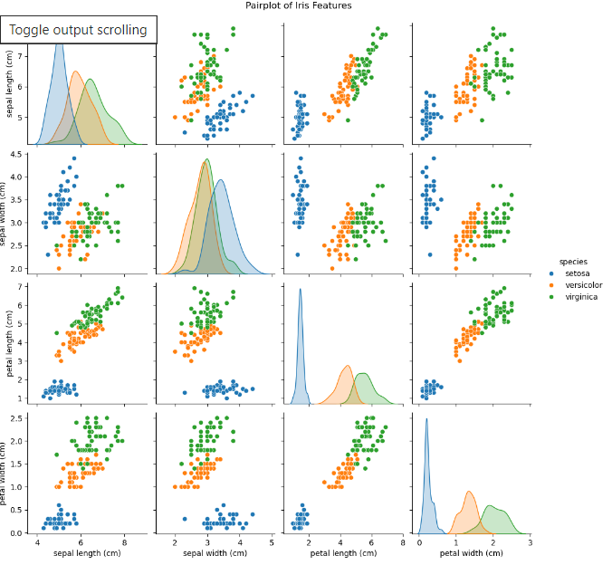
Plot interpretation
Scatter Plot:
Distinct Clustering: Purple dots (setosa) show clear, unique separation from others.
Species Overlap: Teal and yellow (versicolor, virginica) close but with noticeable differences.
Correlation Observation: Positive correlation indicates larger sepals correspond to longer petals.
Pairplot:
Diagonal Plots: Individual species feature distributions visualized with kernel density estimates.
Feature Variations: Setosa smaller/narrower; Versicolor and Virginica show significant overlap.
Bivariate Relationships: Strong correlations highlight clear species differentiation, especially in petals.

Slide 9
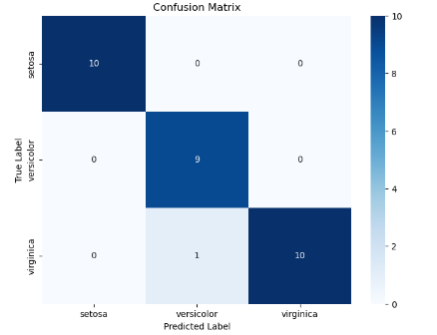
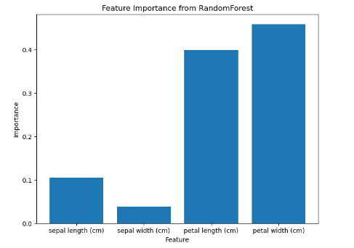
Plot interpretation
Feature Importance:
Graph Axes: X-axis displays Iris features—sepal and petal dimensions; Y-axis shows their importance scores from the Random Forest model.
Petal Metrics' Significance: Petal width and length are the most critical features, significantly influencing species classification.
Sepal Features' Impact: Sepal length shows moderate importance, while sepal width has the least impact on classification accuracy.
Confusion Matrix:
High Accuracy: Model perfectly classifies Setosa, effectively distinguishes Virginica with few errors.
Class-Specific Precision: Setosa 100% accurate; Versicolor, Virginica mostly correct with minor errors.
Minimal Misclassifications: Model excels with only one misclassification, demonstrating strong species identification.

Slide 10

Thank You

